Slide 1
Extractive Transparency Day
and Grand Launching
SEKRETARIAT EITI INDONESIA
https://eiti.esdm.go.id

Slide 2
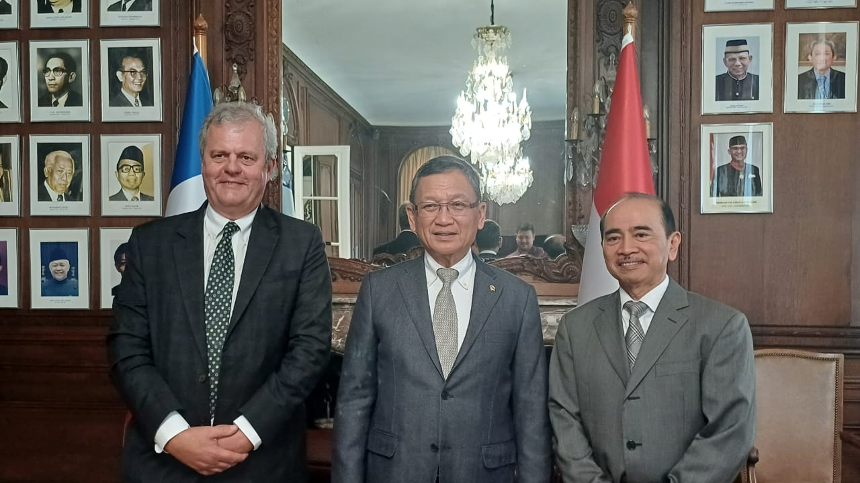
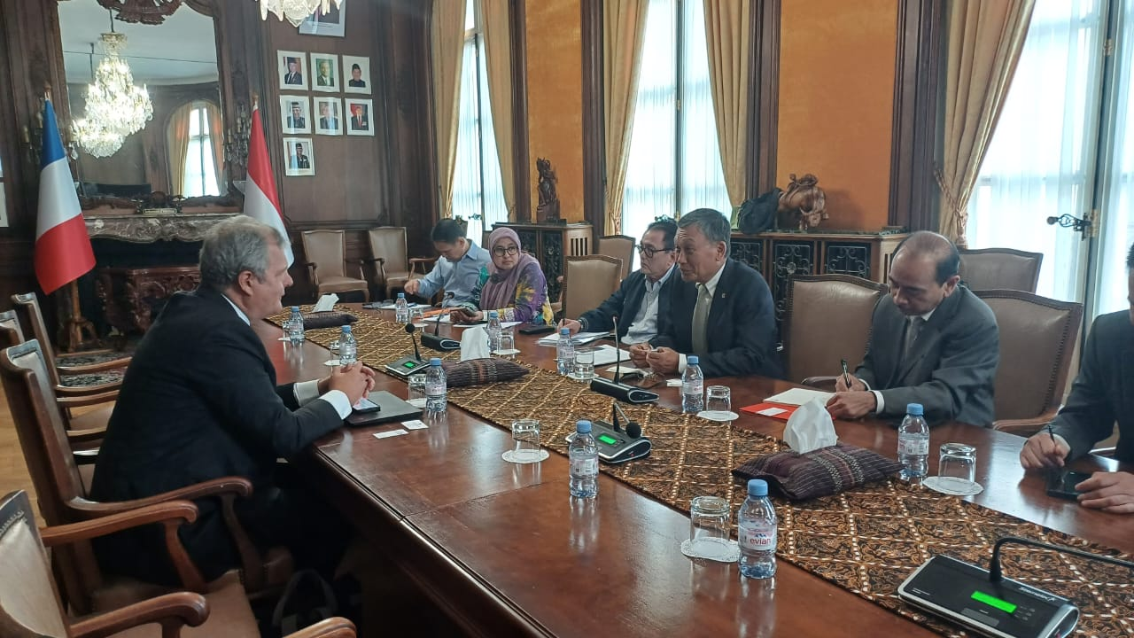
Statement High Level Meeting
Link MEMR and MOF
https://tinyurl.com/297e29e6 link video testimony Webinar “Transparansi Pemanfaatan Sumber Daya Alam kepada Publik Sebagai Upaya Good Governance” dan Sosialisasi Laporan EITI Indonesia Ke-8 (Flexible Report)
https://eiti.esdm.go.id/en/pertemuan-antara-menteri-esdm-dengan-eksekutif-direktur-eiti-internasional-di-paris/ Minister for Energy and Mineral Resources, Arifn Tasrif met with CEO of EITI International Secretariat, Mark Robinson on September 27, 2023. In this meeting the minister shared his commitment towards more transparency and good governance in extractive sectors.

Slide 3
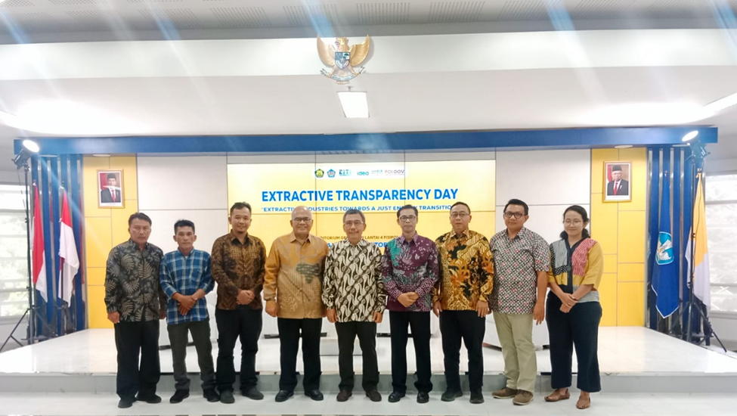
Extractive Transparency Day News
Link ESDM
https://eiti.esdm.go.id/kementerian-esdm-menyelenggarakan-extractive-transparency-day-sebagai-rangkaian-peluncuran-portal-data-esktraktif/
Link Media
https://dpp.fisipol.ugm.ac.id/mendorong-transisi-energi-yang-berkeadilan-dalam-kegiatan-extractive-transparency-day/
https://pwypindonesia.org/en/extractive-transparency-day-contextualizing-extractive-industry-data-and-information-transparency-in-the-framework-of-just-energy-transition/

Slide 4
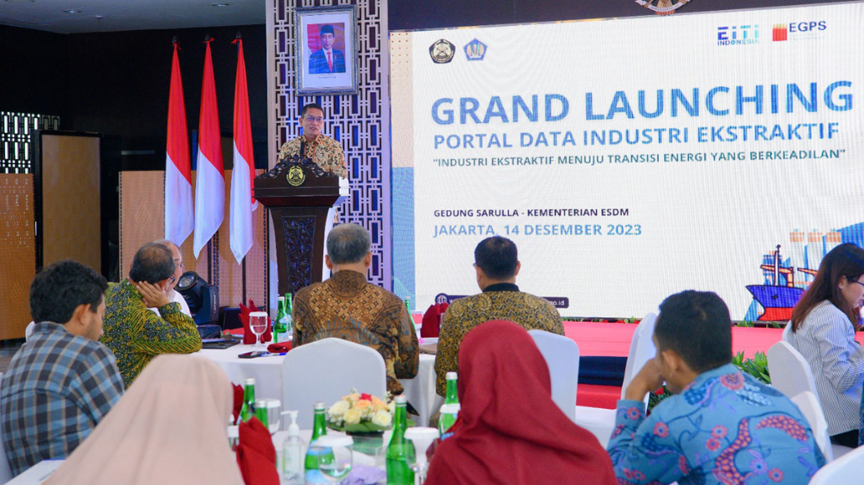
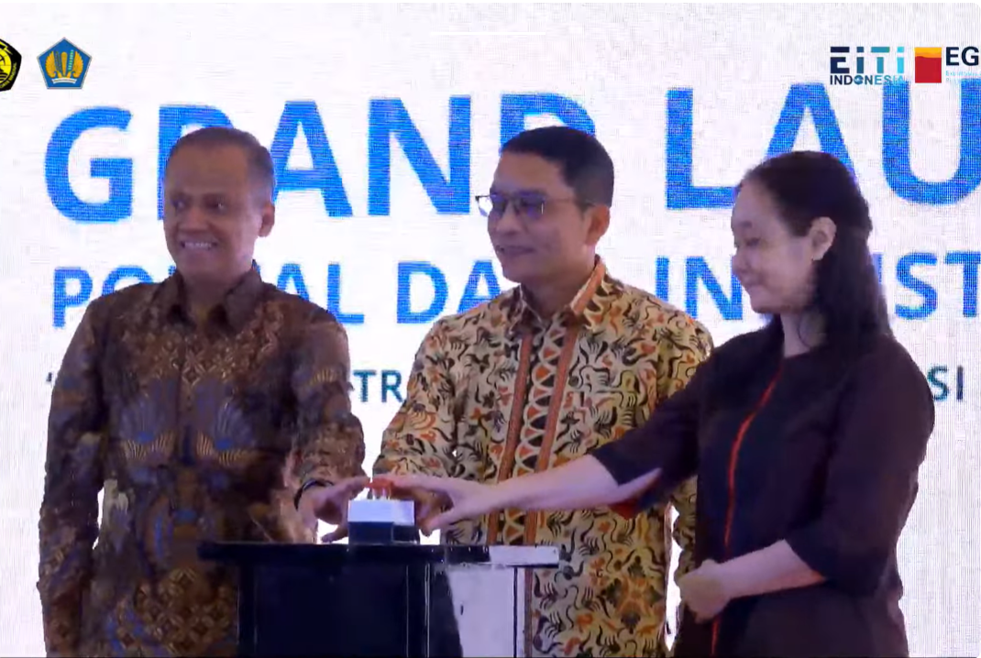
Grand Launching Portal Data
Link MEMR and MOF
https://www.kemenkeu.go.id/informasi-publik/publikasi/berita-utama/portal-data-ekstraktif
And
https://www.esdm.go.id/id/media-center/arsip-berita/tingkatkan-kualitas-akuntabilitas-pemerintah-luncurkan-portal-data-industri-ekstraktif-
Link Media
https://katadata.co.id/happyfajrian/berita/657aee1027489/esdm-gandeng-bank-dunia-luncurkan-portal-data-industri-ekstraktif
https://finance.detik.com/energi/d-7090065/kepo-sama-nilai-kontribusi-batu-bara-cs-akses-di-sini
https://kumparan.com/kumparanbisnis/berantas-korupsi-kementerian-esdm-bikin-portal-data-industri-ekstraktif-21liVZz9CFu

Slide 5
TERIMA KASIH
https://eiti.esdm.go.id

